Slide 1
Acropolis Institute of Technology And Research, Indore
Department of CSIT.
Subject: Evaluation of Internship
Topic: Keylogger cyber security thread
Submitted to:
Prof. Nidhi Nigam
Submitted By:
KARTIK AHIRRAO (0827CI201092)

Slide 2
Contents
What is Key logger
Path settings of key logger in widows
Set up the environment
Implementing
Showing Demonstrate How the application works.
Technology detail

Slide 3
What is key logger?
Basically key logger is malicious software to record everything you type like password , social security number, credit card number everything b/w you type is being logged hence the name is key logger. the cocept and definition is basic but the power of this application is endless.
Password
Credit card Number #’s
Username #’s
SSN #’s
ETC……

Slide 4
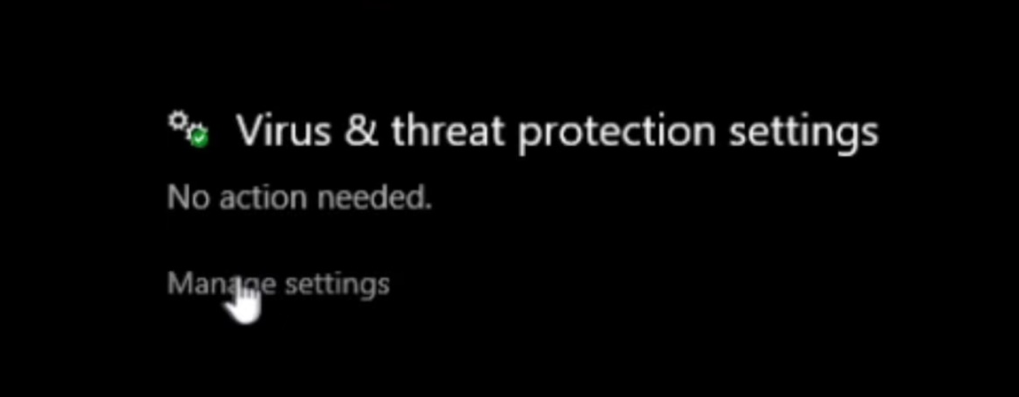
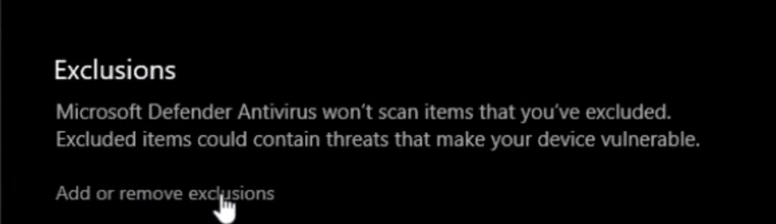
Path Settings -
First we have to set the path of that key logger through the widows settings ->
PATH- Window start ->virus and threads protection
->manage settings-Exclusion category
->select keylogger folder

Slide 5
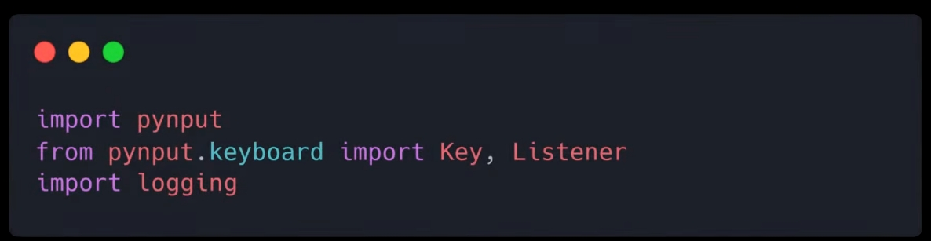
Implementing
Here , we will use (visual studio code) and also we have to need of pynput python library for recording the user inputs and then we import pynput.keyboard and also pynput, listener
and then import logging to get all detail in txt file.

Slide 6
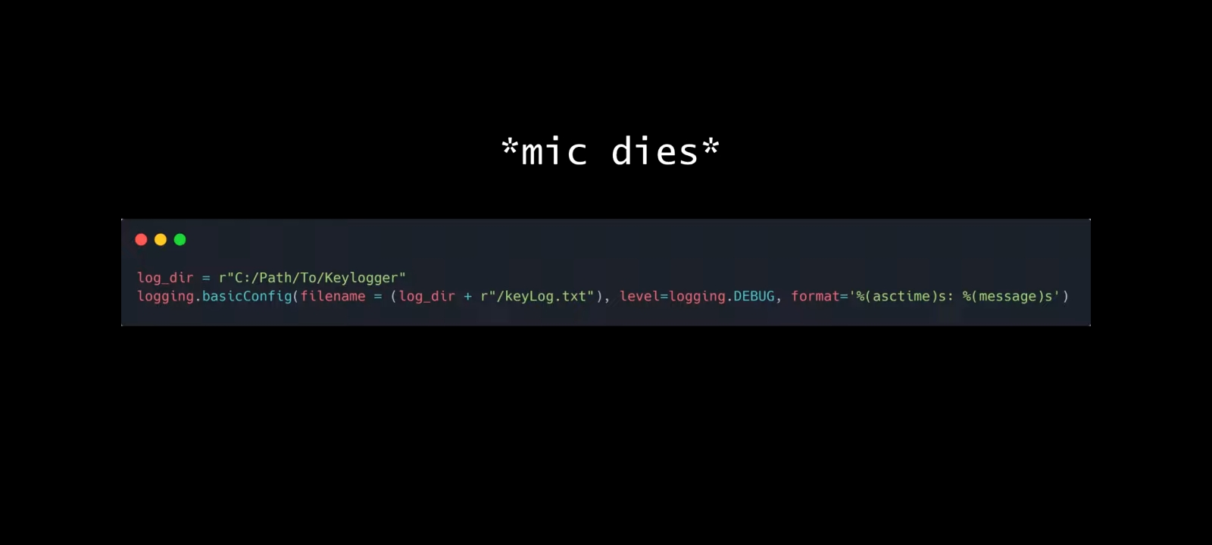
Implementing
Now we are going to specify the path where the log file will be stored and this log file will include all of the moniter keystrokes in the format specified so it is going to store in log directory in keylog.txt

Slide 7
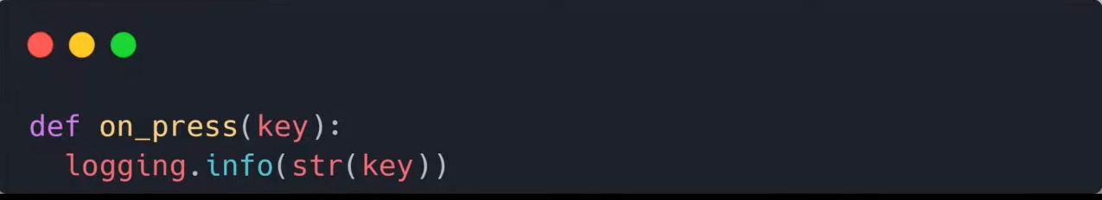
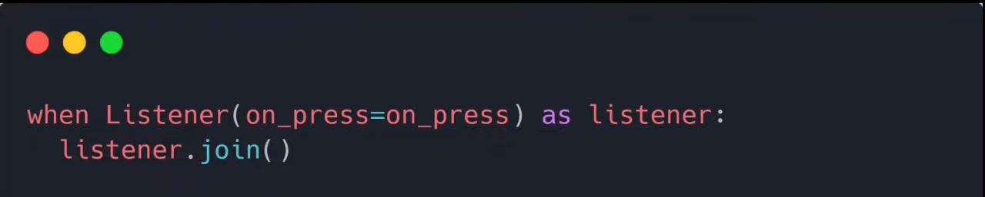
Implementing
Than we call the on press function ,which will take every key press as a parameter than it will log this information
, and than finally we will create a listener instance and define on-press method and join it with the main program thread.

Slide 8
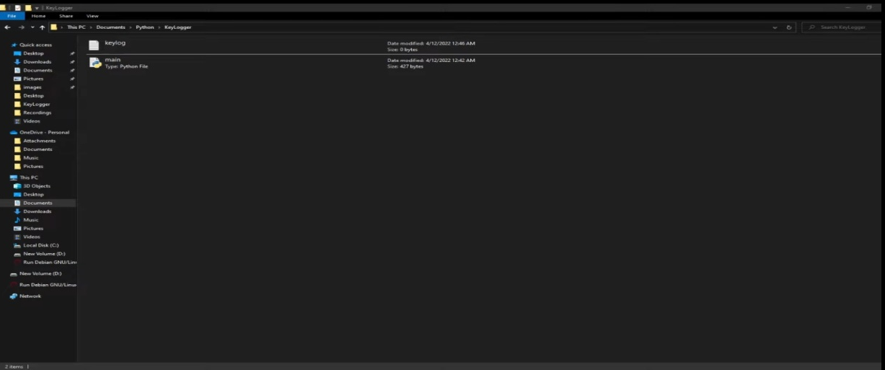
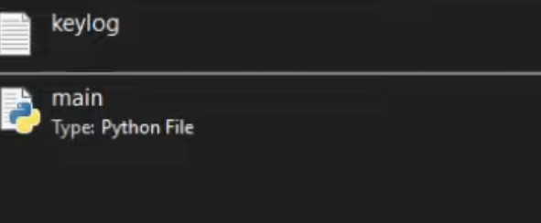
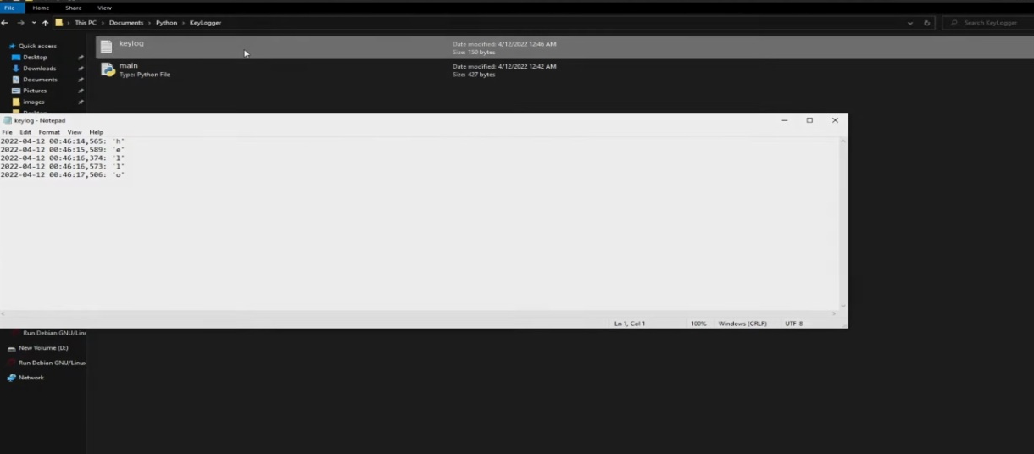

Demonstrate
Alright Now, you can see the main file on the screen that we will launch it than it made the file keylog.txt than
Now, I am just typed “hello” in keyboard than if you open keylog.txt file it shows->

Slide 9
Technology stack
Software Detail:
Python
Hardware Detail:
Device(Laptop)
Internet connection
Visual studio code

Slide 10
Conclusion

